Slide 2

Introduction to Data Analysis and Business Intelligence (BI)
Santiago Paiva

Slide 3
Presentation Overview
Introduction (4 min)
Part 1: Overview of BI Tools (10 min)
Part 2: Google Webmaster Tools (10 min)
Part 3: Google Adwords (10 min)
Conclusion (1 min)
Q & A (10 min)
Slides: https://www.github.com/spaiva/confoo-2017

Slide 4
About Me
Currently at Montreal Neurological Institute (Neuroscience)
Startups
Busbud (Travel)
Frank + Oak (Retail)
Sharethebus (Travel)
Research
Polytechnique (Astrophysics)
McGill University (AI)
MIT (Energy)
Confoo
2014: https://www.github.com/spaiva/confoo-2014
2016: https://www.github.com/spaiva/confoo-2016

Slide 5
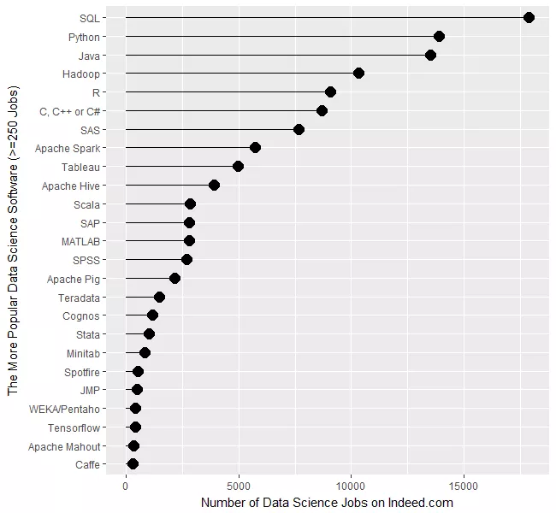
http://r4stats.com/2017/02/28/r-passes-sas/

Slide 6

78% are planning to increase the use of cloud for BI and data management in the next twelve months.
46% of organizations prefer public cloud platforms for cloud BI, analytics and data management deployments.
78% are planning to increase the use of cloud for BI and data management in the next twelve months.
46% of organizations prefer public cloud platforms for cloud BI, analytics and data management deployments.
Cloud BI adoption increased in respondent companies from 29% to 43% from 2013 to 2016.
Almost half of organizations using cloud BI (46%) use a public cloud for BI and data management compared to less than a third (30%) for hybrid cloud and 24% for private cloud.
The Business Application Research Center (BARC) and Eckerson Group, 2017

Slide 7
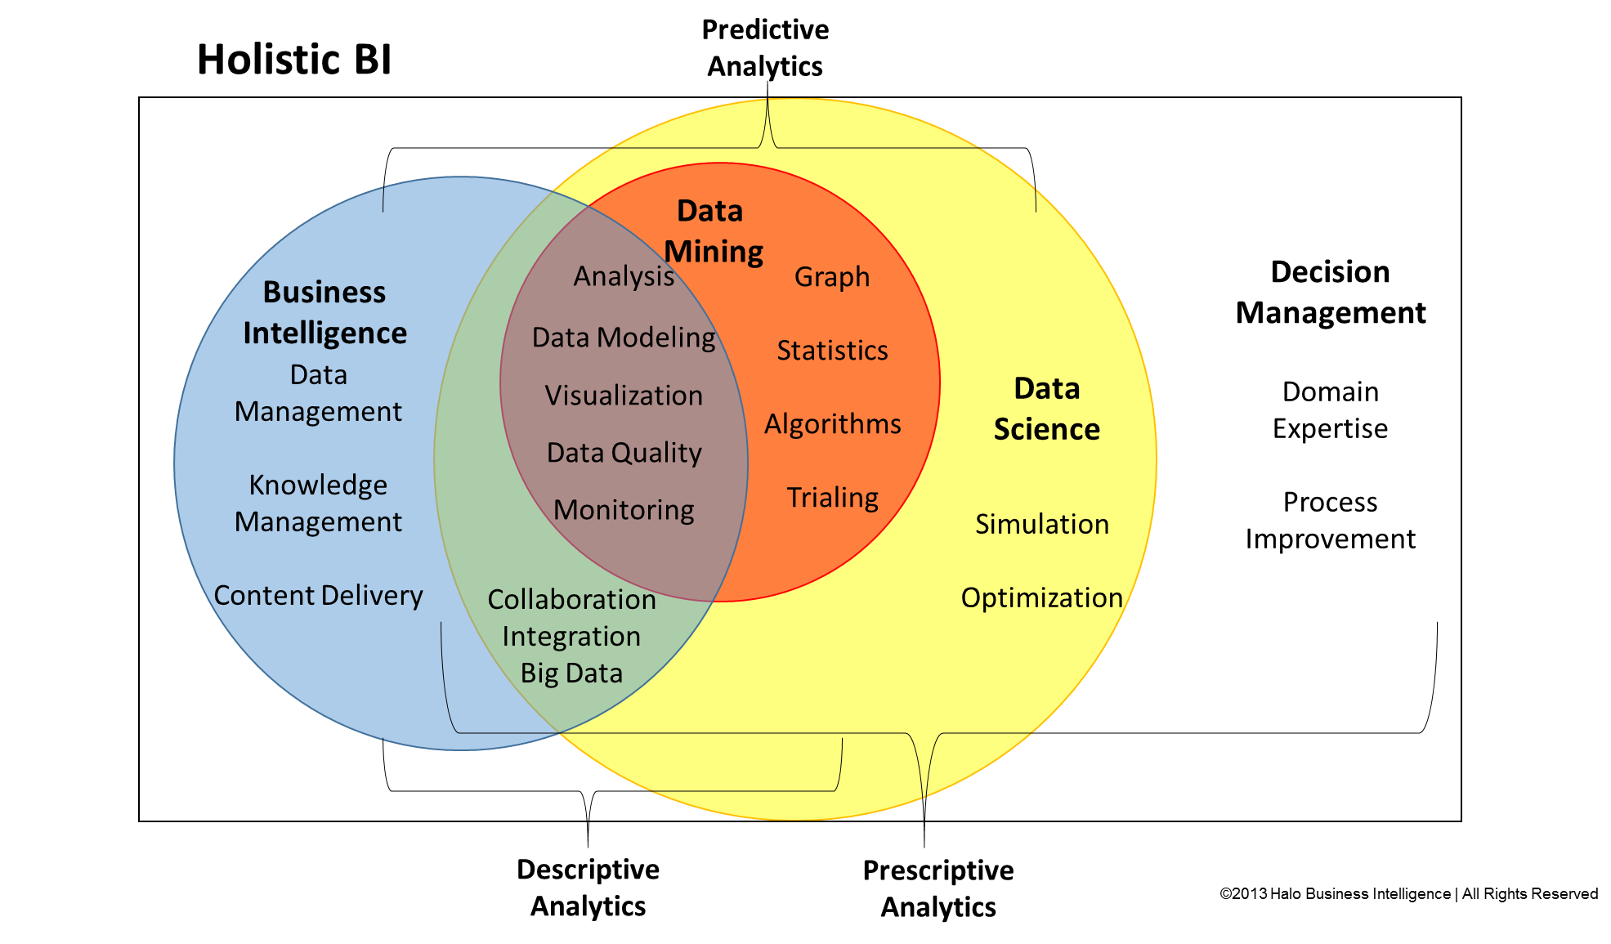
Business Intelligence vs Data Scientist
Halo Business Intelligence, 2013

Slide 8
The rise of the Full-Stack Data Analyst
Data Management
Data Science / BI
Data Visualization
MySQL
PostgreSQL
MongoDB
Redis
Cassandra
DW
Excel
D3
HighCharts
Google Visualization
Grafana
...
Excel
SQL
Python
R
Hadoop
...

Slide 9
Part I: BI Tools

Slide 10

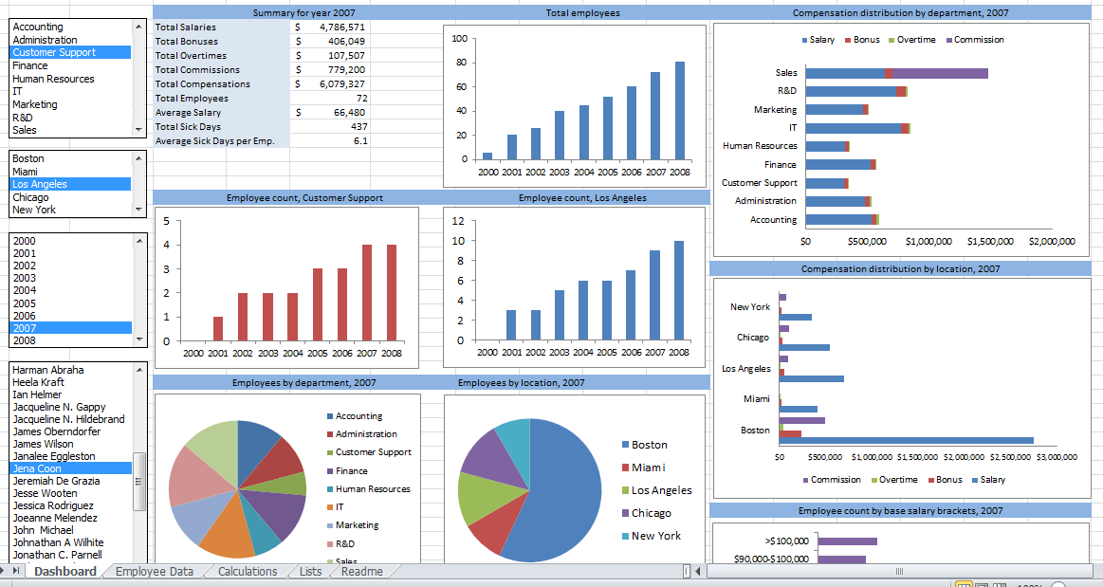
Tool #1: Microsoft Excel
Still very important!
Powerful Macros
VLOOKUP and Pivot Tables
Rapid prototyping
https://apandre.wordpress.com/2011/06/05/excel-as-bi-platform/

Slide 11

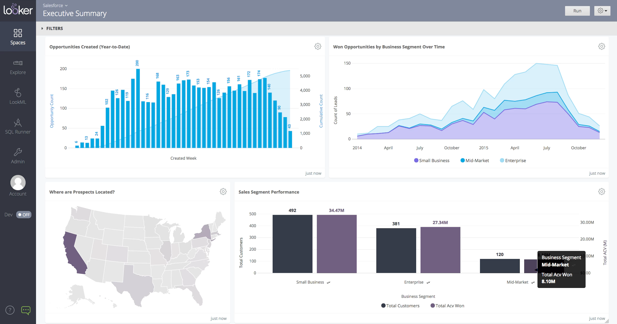
Tool #2: Looker
LookML Language
Derived Tables
Custom Dashboards
Very common in e-commerce
Examples: Frank + Oak and Breather
https://www.getapp.com/business-intelligence-analytics-software/a/looker/

Slide 12

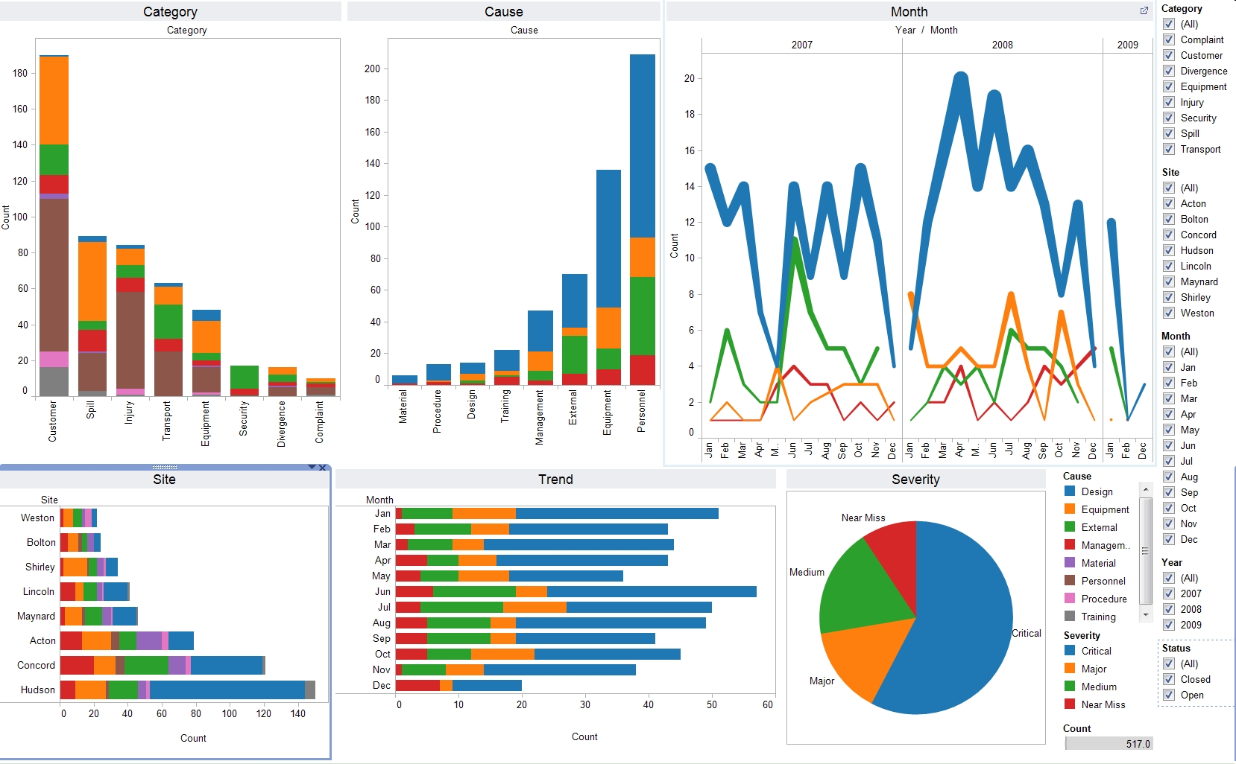
Tool #3: Tableau
Popularity ⇧⇧⇧
Pretty User Interface
Get moving quickly
Rapid prototyping
https://apandre.wordpress.com/category/tableau/

Slide 13
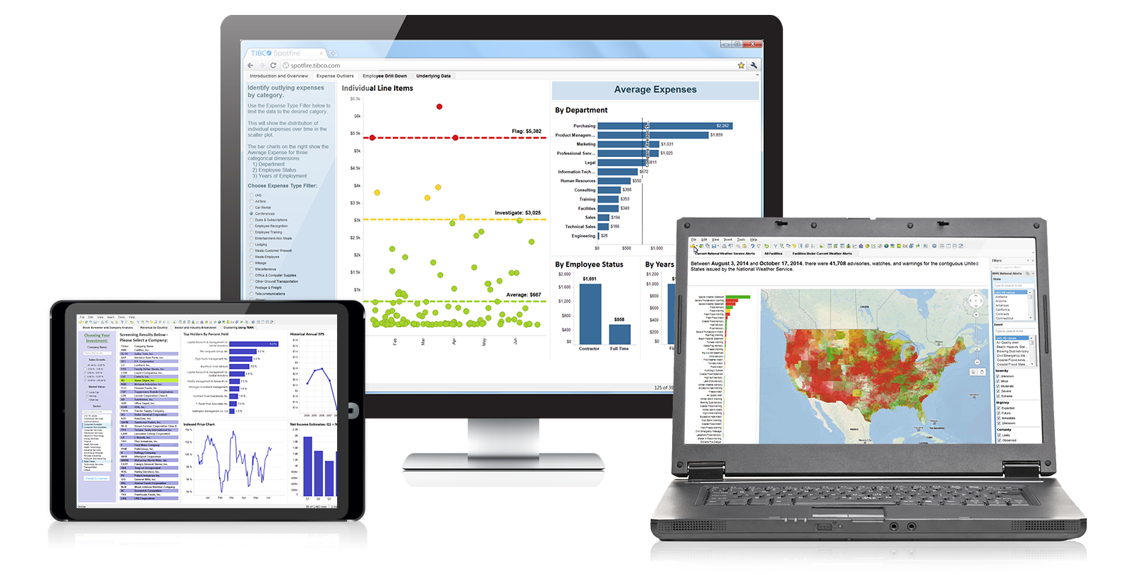

Tool #4: TIBCO Spotfire
Vivek Ranadivé
Heavy lifting
Requires knowledge of Statistics!
http://spotfire.tibco.com/

Slide 14

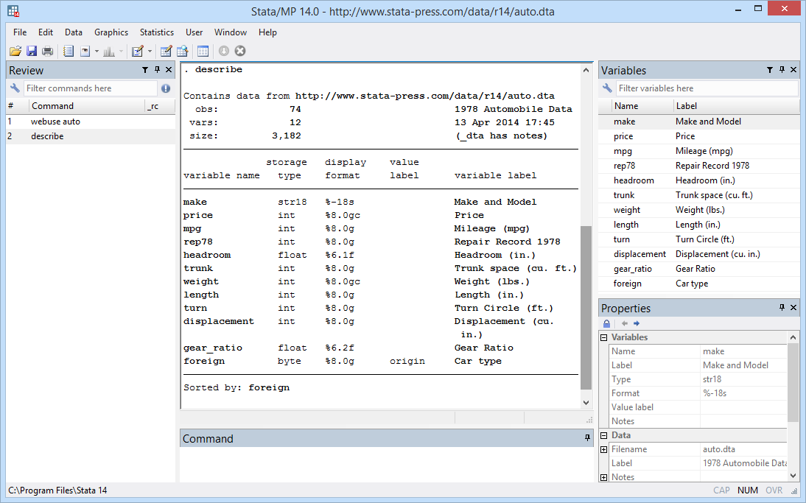
Tool #5: Stata
Simulation
Modelling
Heavy on Statistics
Highly Recommended
http://www.stata.com

Slide 15

Tool #5: Stata
Previously at NY Times
Massive Monte-Carlo Simulations on Stata during American Elections
Now doing Sport Analytics
https://FiveThirtyEight.com
http://www.politicususa.com

Slide 16
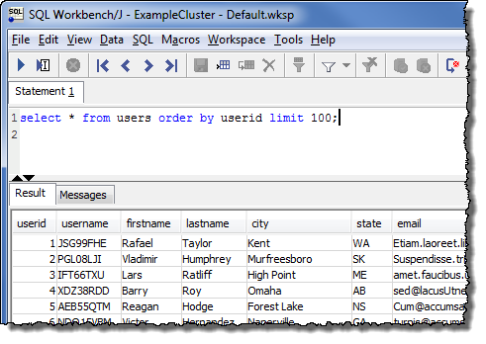
Tool #6: SQL Workbench/J
Personal Favourite!
Execute SQL Commands to explore data spontaneously
Very flexible
http://www.sql-workbench.net/
https://docs.aws.amazon.com/redshift/

Slide 17
*Attention*

Slide 18
We can build our own BI tools!

Slide 19
Part II: Google Webmaster Tools

Slide 20
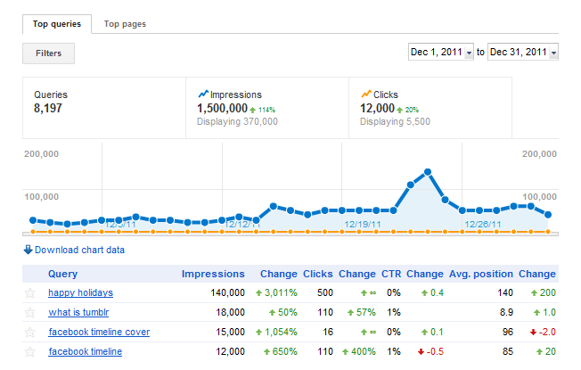
Google Webmaster Tools (GWT)
http://amintor.com/1/post/2013/11/technology-extend-python-library-for-google-web-master-tools.html

Slide 21
Google Webmaster Tools (GWT)
URL: https://www.google.com/webmasters/
BI Tool: https://gist.github.com/spaiva/c7519dc3b2c78c94f2b2ee9a05f9785d
Data Analysis (Pandas): https://gist.github.com/spaiva/083387046ebfec858316

Slide 22
Part III: Google Adwords

Slide 23
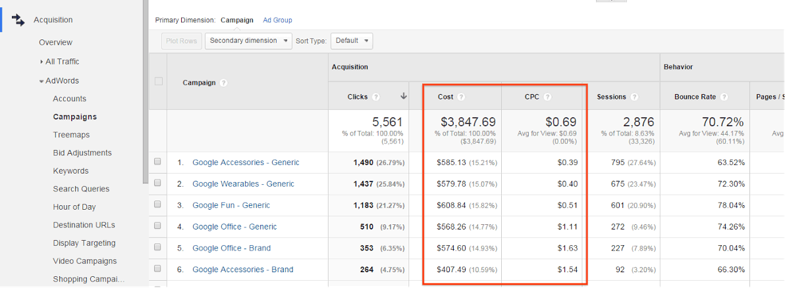
Google Adwords
https://www.shopify.com/blog/16909640-how-to-spend-your-first-100-on-google-adwords

Slide 24
Google Adwords
Types of reports:
ACCOUNT_PERFORMANCE_REPORT
CRITERIA_PERFORMANCE_REPORT
KEYWORDS_PERFORMANCE_REPORT
CAMPAIGN_PERFORMANCE_REPORT
AD_PERFORMANCE_REPORT
AD_GROUP_PERFORMANCE_REPORT
PAID_ORGANIC_QUERY_REPORT
URLS_PERFORMANCE_REPORT
There are a total of 43 types of reports!
Source: https://developers.google.com/adwords/api/docs/appendix/reports

Slide 25
Google Adwords
URL: https://adwords.google.com/home/
BI: https://gist.github.com/spaiva/745d901675bef85bebac77220df2b08f
Data Analysis: https://gist.github.com/spaiva/135bbb5e6392fa6c567fbe79fe2d297a

Slide 26
Future of BI
Security
Privacy / Ethics
Predictions and Call to Action
*Customer Retention*

Slide 27
Conclusion
Overview of BI Tools
Excel, Looker, Tableau, TIBCO Spotfire, Stata
Attention of the consumer
Custom BI Tool #1: Google Webmaster Tools (GWT)
GTW Python Library (gwt.py)
Custom SEO functions using Pandas (df.py)
Custom BI Tool #2: Google Adwords
GA Python Library (ga.py)
Custom function using Pandas (ga_models.py)

Slide 28
Q & A
Introduction to Data Analysis and Business Intelligence (BI)
Santiago Paiva
paiva.santiago@gmail.com
Twitter: @stronnics
github.com/spaiva/confoo-2017

